Slide 1


Slide 2
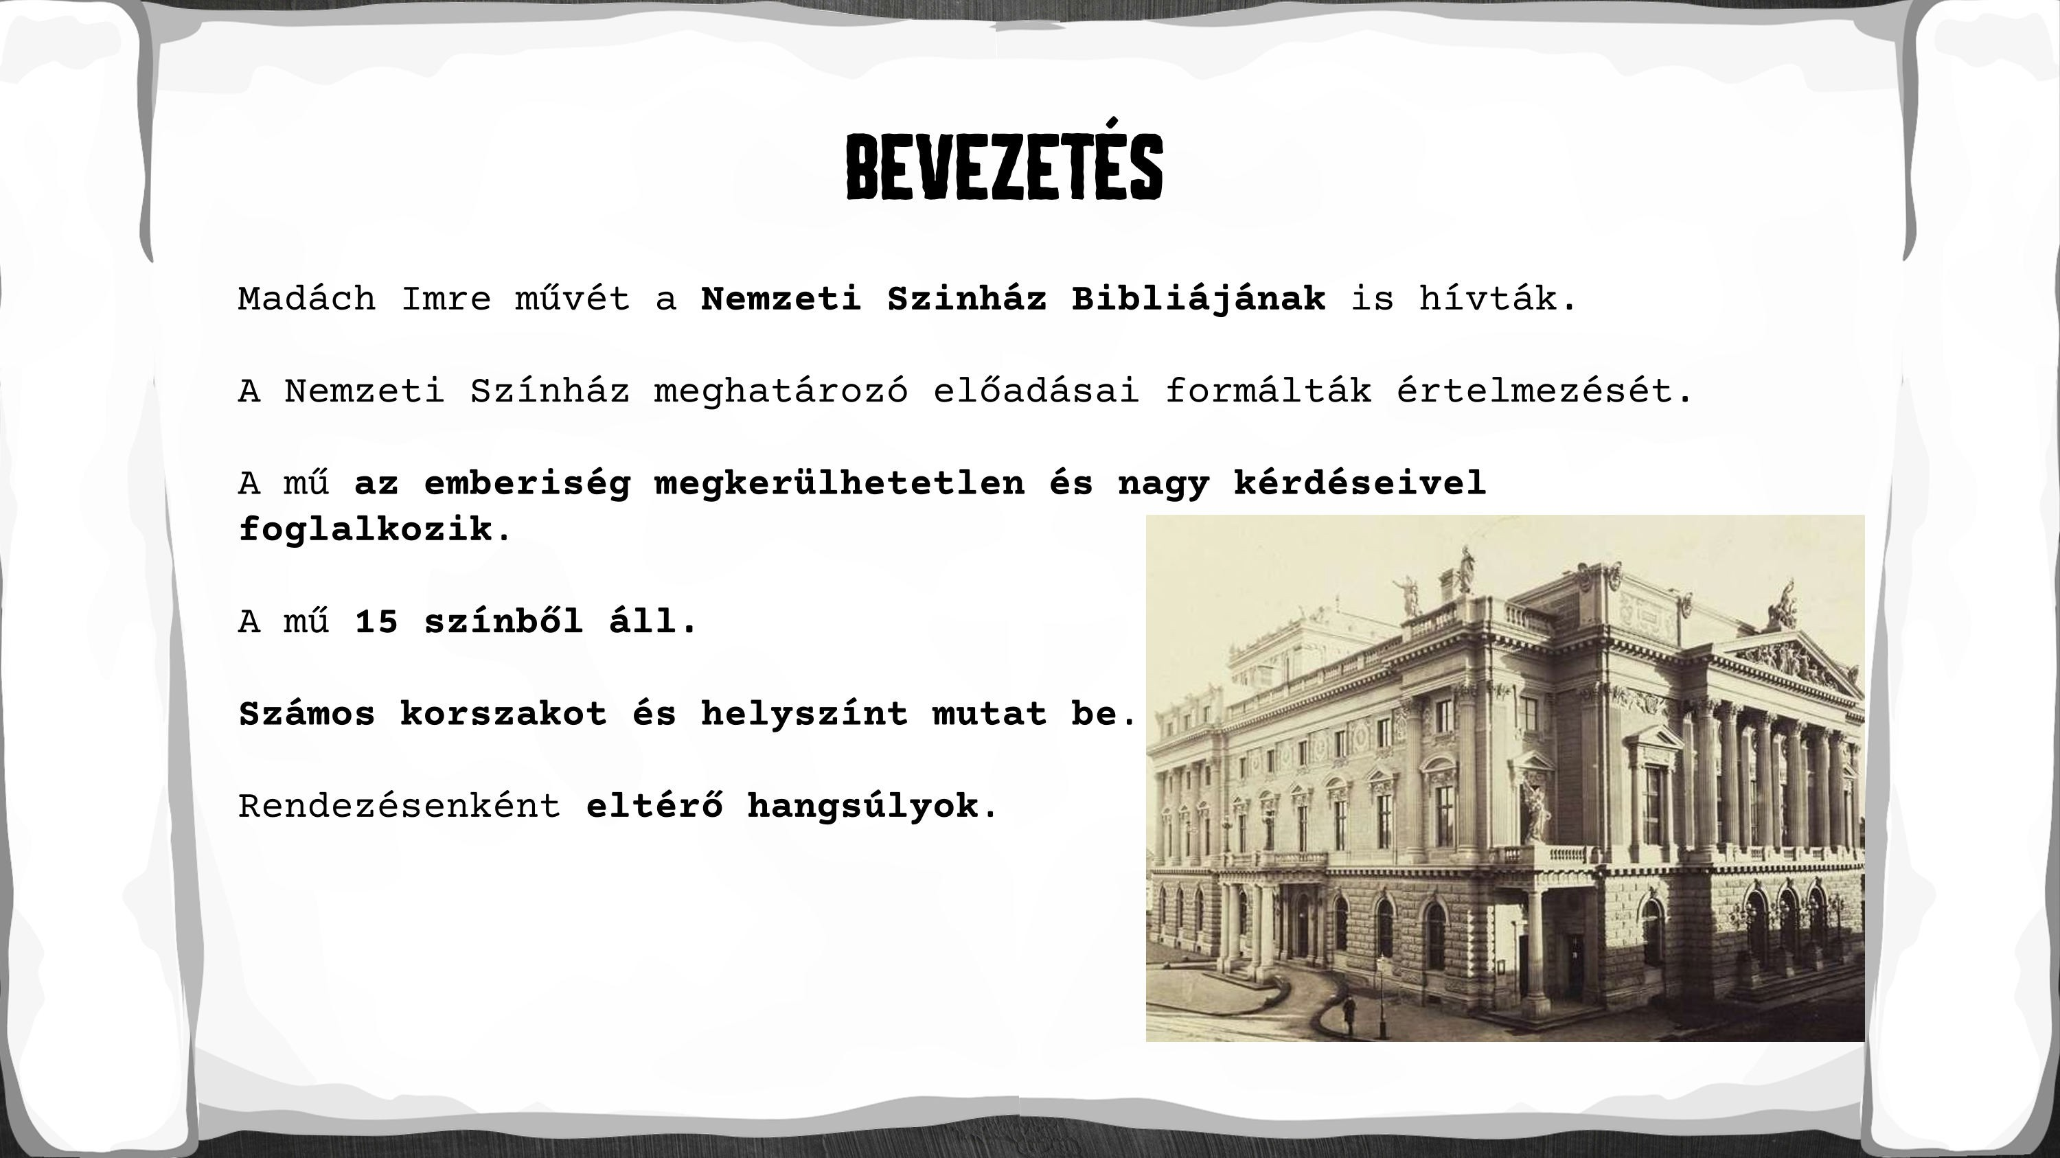

Slide 3
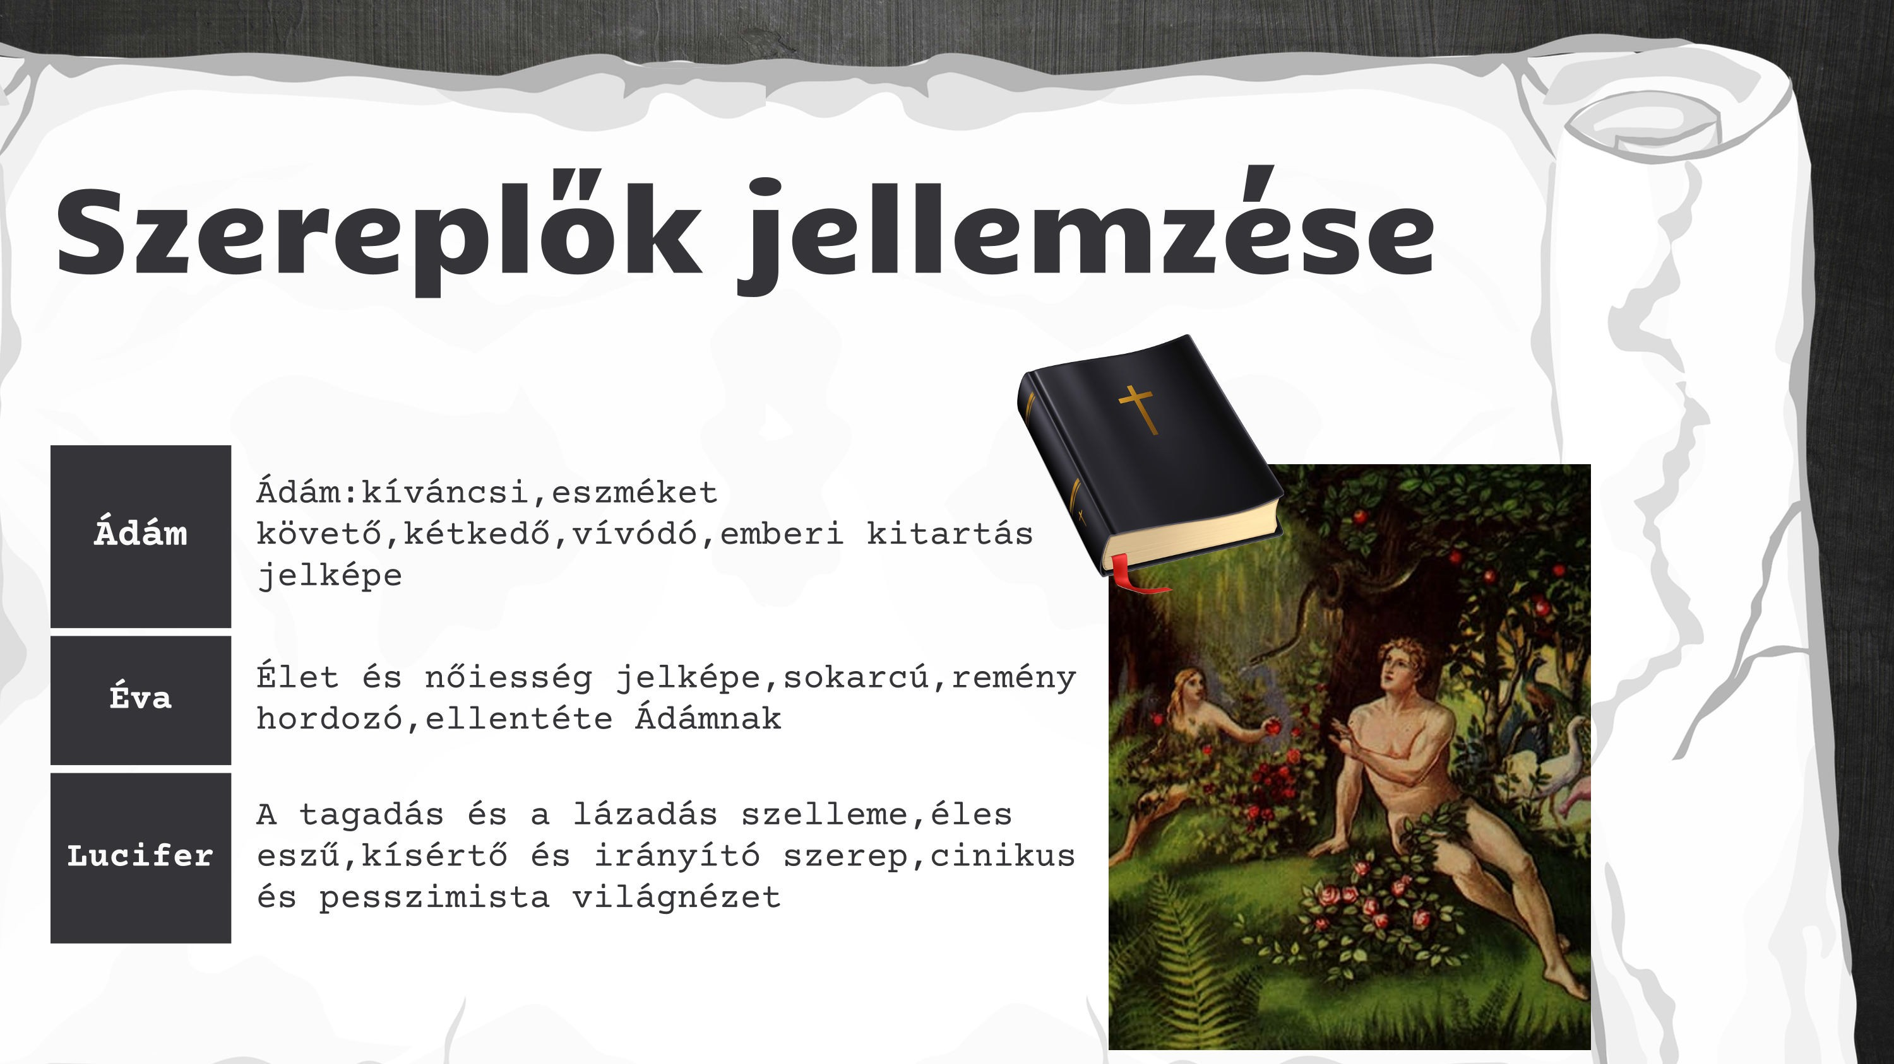

Slide 4
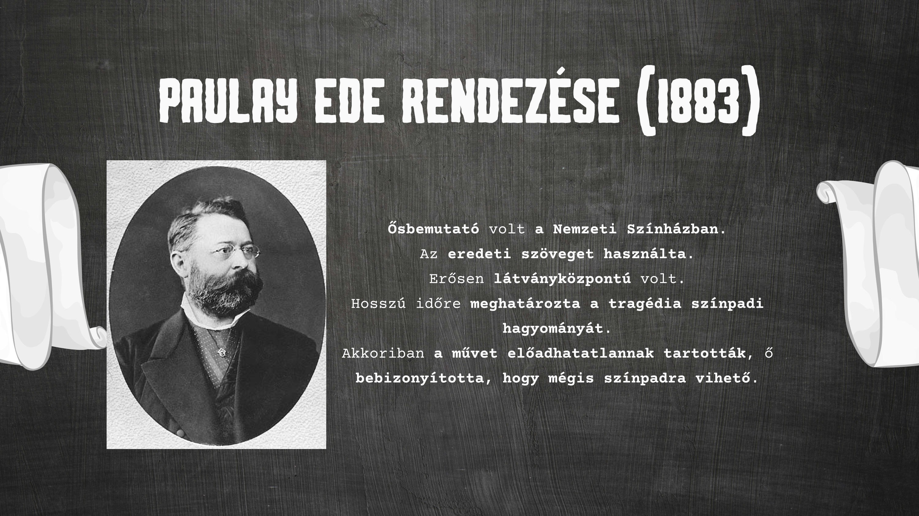

Slide 5
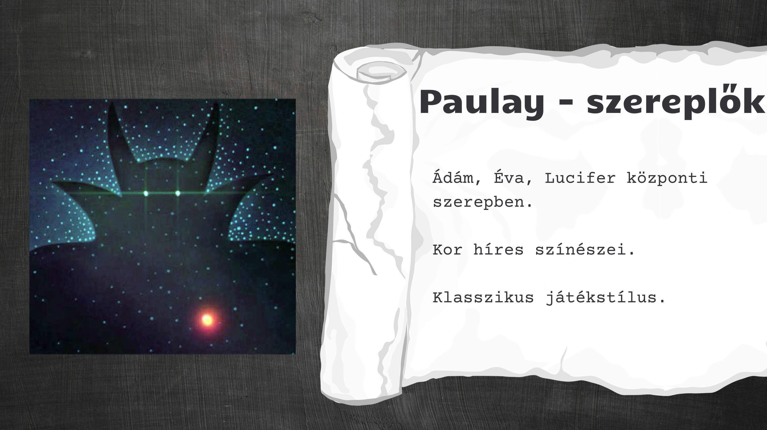

Slide 6
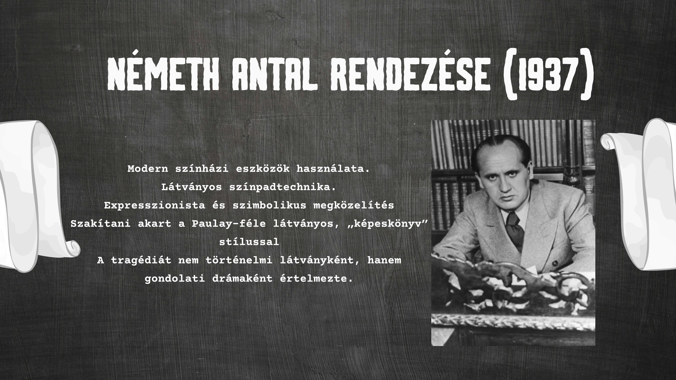

Slide 7
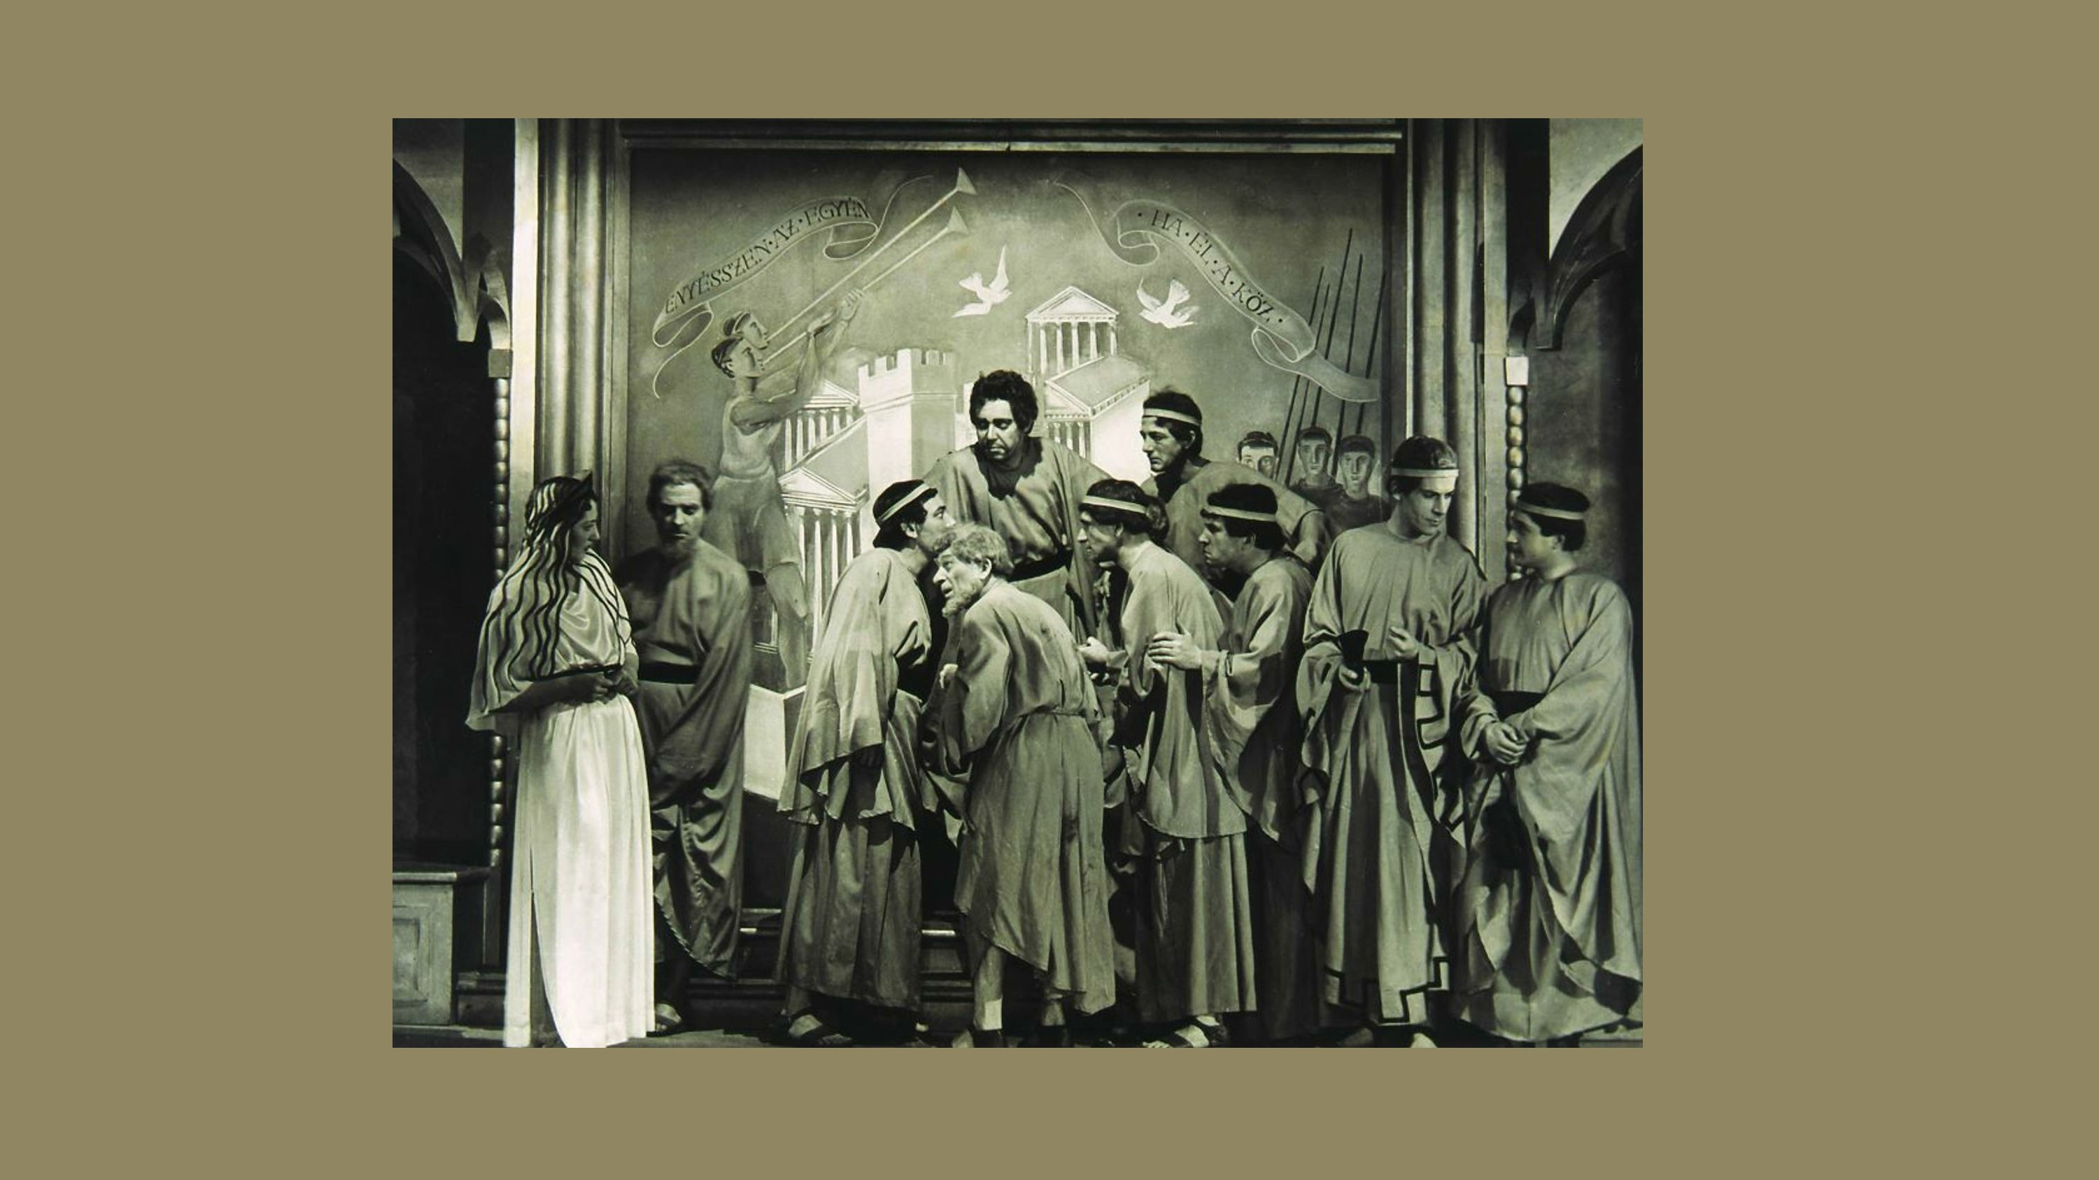

Slide 8
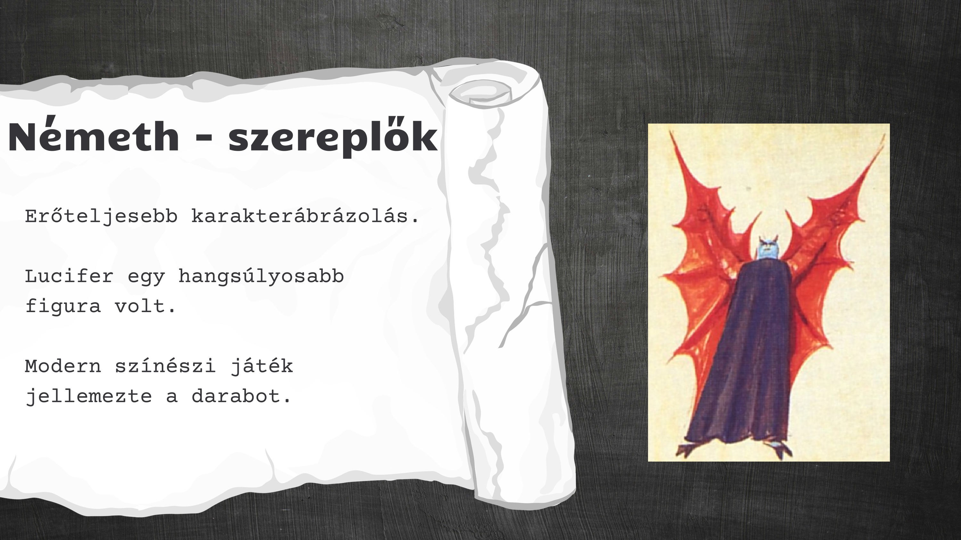

Slide 9


Slide 10
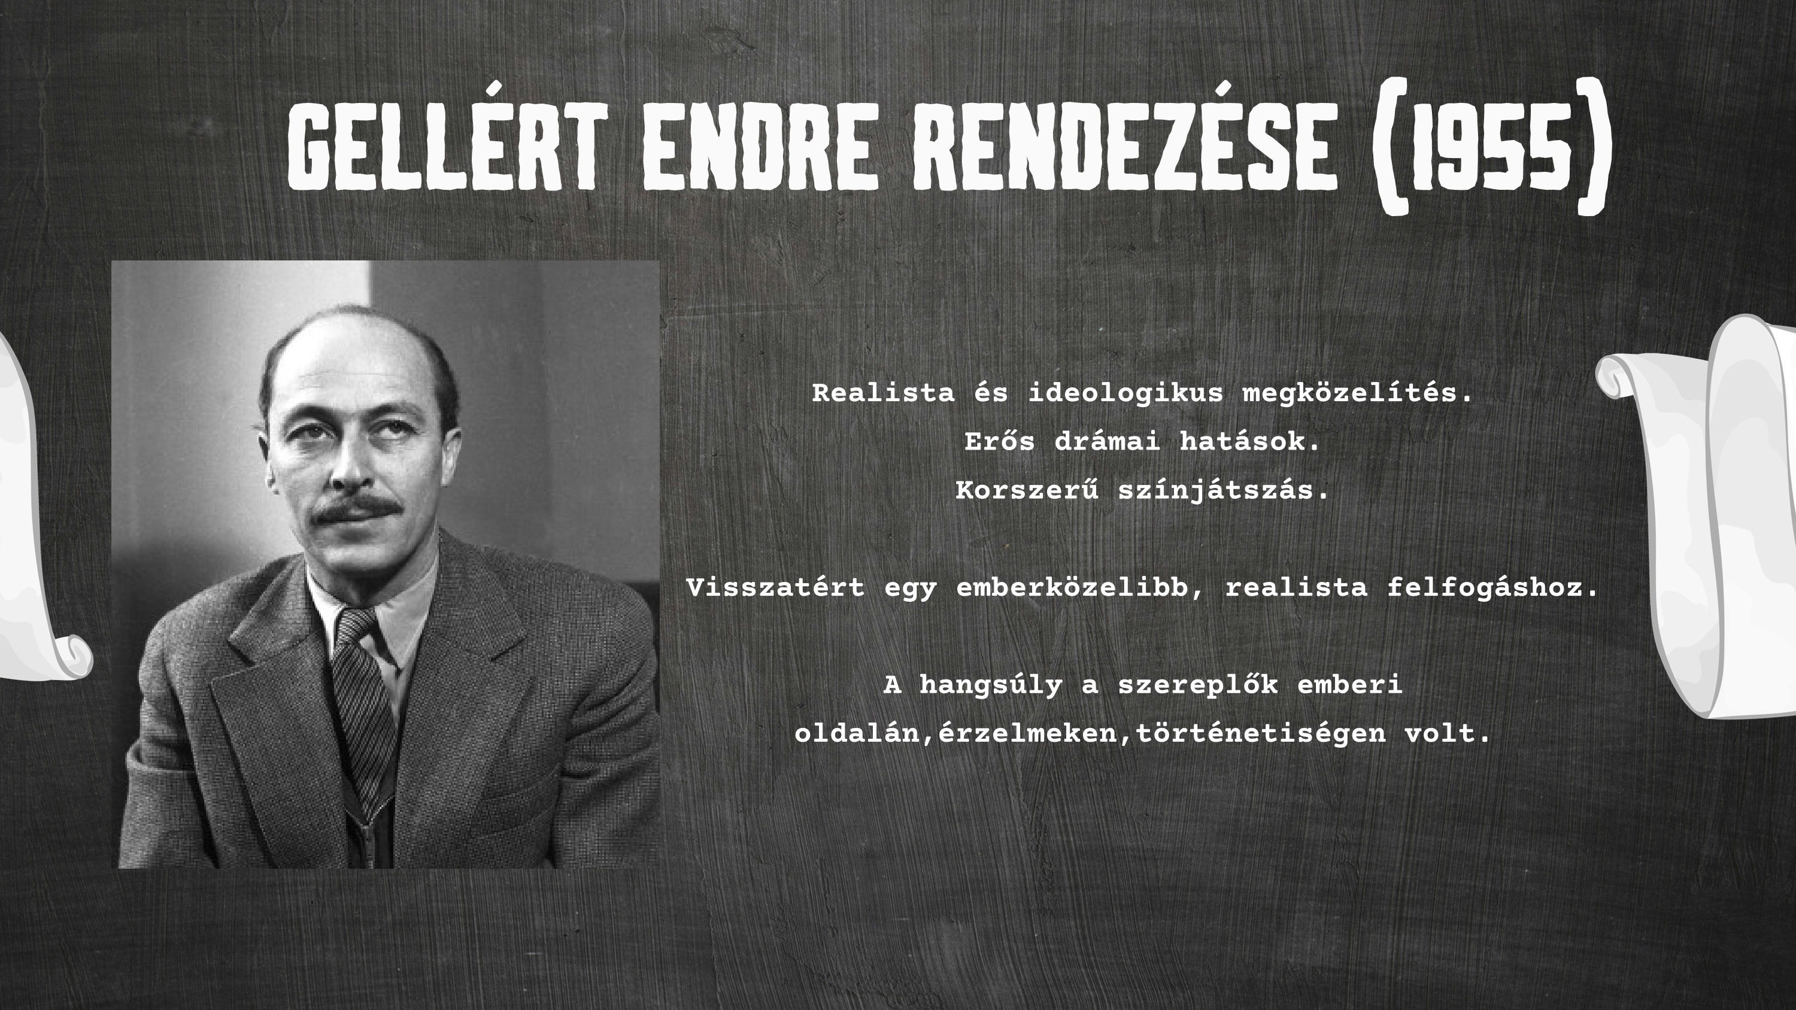

Slide 11
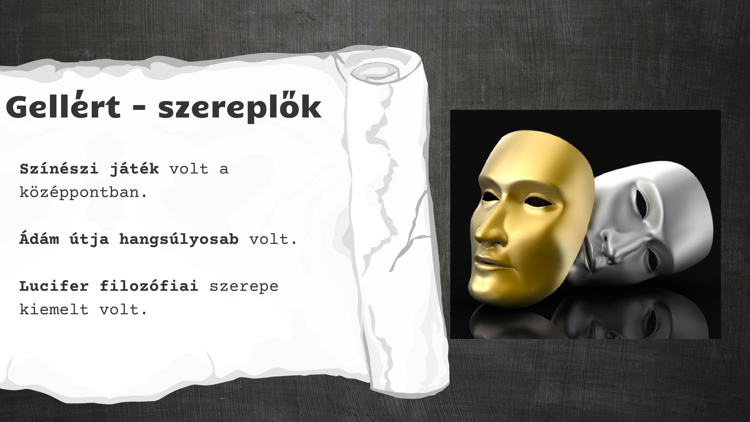

Slide 12

https://www.canva.com/design/DAHFJ0l08D0/w-ZM0V7mkqfeTU-7RWJOmQ/view?utm_content=DAHFJ0l08D0&utm_campaign=designshare&utm_medium=link2&utm_source=uniquelinks&utlId=he67e356a5a

